Slide 1
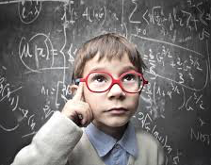
How RFT Can Make You Smarter ACBS 2018/Montreal
Sarah Cassidy, PhD

Slide 2
How RFT Can Make You Smarter Rue St. Paul ACBS 2018/Montreal
Dr. Sarah Cassidy
B.S. (hons) Psychology, PhD Psych Science
Cert. CBT, ACT & MBI
Professional Member APA, Chartered Member PSI, ACAMH (Ireland), SCPA Panel
Educational, Child and Adolescent Psychologist Smithsfield Clinic
Lecturer in Educational Psychology and Child Development
Chief Education Officer at RaiseYourIQ

Slide 3
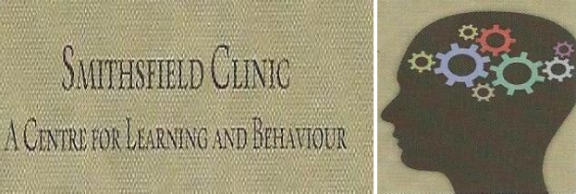

Slide 4
S.M.A.R.T
Strengthening Mental Abilities with Relational Training

Slide 5
What is SMART?
SMART is a scientifically developed educational training programme that has published scientific evidence that it can raise intelligence levels (measured using standardised IQ tests) by 20 - 30 IQ points. This makes SMART training a breakthrough in psychological science.

Slide 6
SMART is based on the new scientific discovery that "relational skills" underlie most forms of intelligence. Our computer based online training programme helps people to enhance their relational skills and their intellectual skills go up as a result.

Slide 7
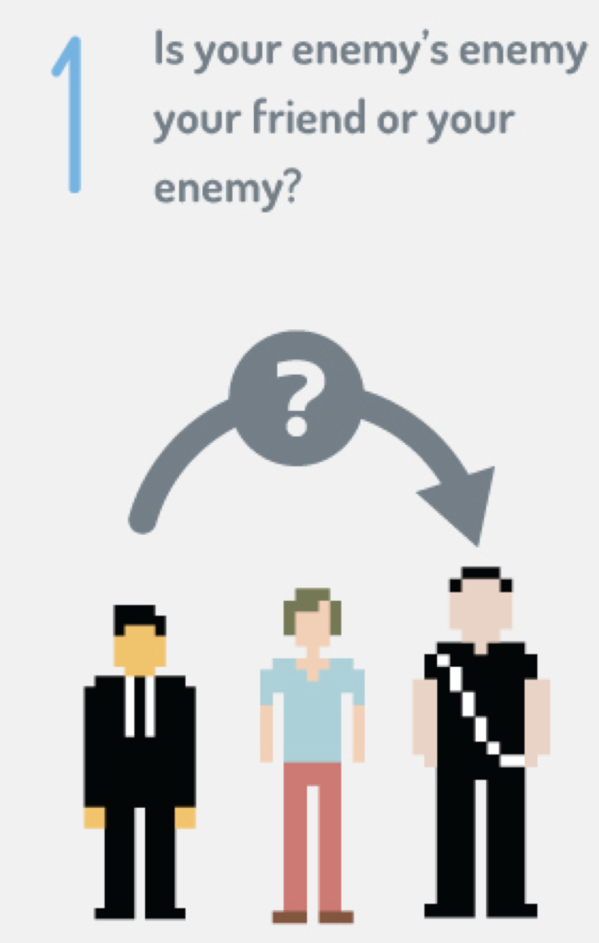
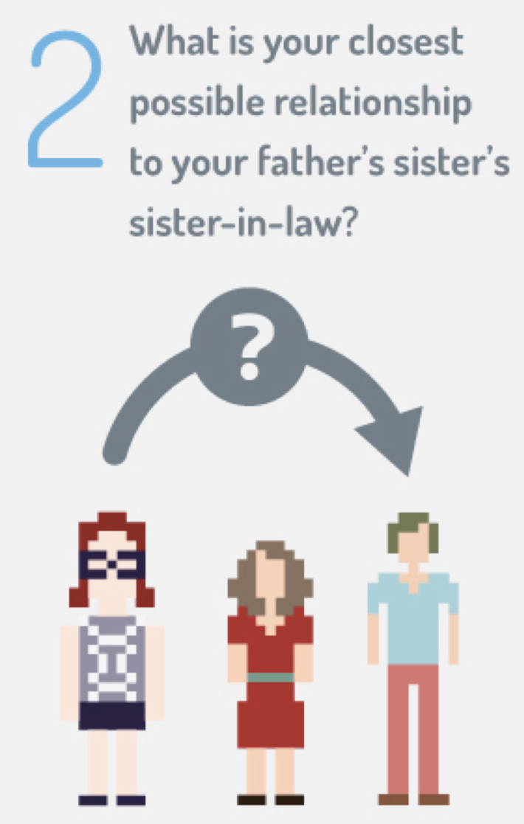
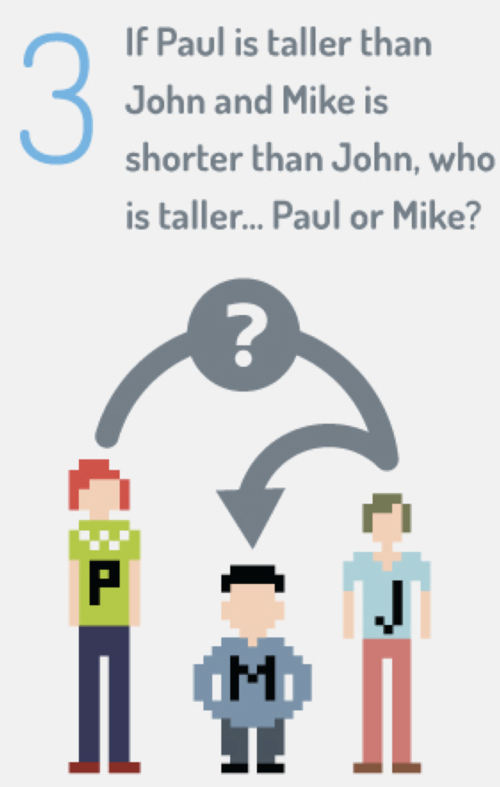
Notes:
Here are some puzzles that require relational skills the read puzzles slowly

Slide 8
Q: Which of these two coins is bigger?
A: The 5c.
The size relation between these coins is non-arbitrary

Slide 9
Which of these two coins is more valuable?
In the context of value the relation
between the coins is ARBITRARY.
“is greater than”
Kids must learn the ABSTRACT nature of “More than”

Slide 10
These examples show us how relational skills are important in every day life for intelligent responding to a variety of different situations.
Intelligence is one of the most controversial topics in psychology today.

Slide 11
We are going to discuss precisely how relational skills underlie intelligence and how we can raise intellectual skills by training these relational skills to a high level of fluency with an online intervention.
We will discuss an ever growing body of published research findings and lots of research still in progress.

Slide 12
Problems with intelligence tests
While the WISC-IV is thought to measure g, it’s entirely possible that it is failing to take other types of intelligence into account

Slide 13
We also know that intelligence tests do not reward novel, creative, or divergent responses

Slide 14
Intelligence tests may be culturally biased

Slide 15
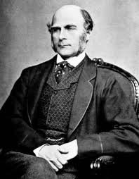
Some historical perspectives...
Francis Galton (1869) "Hereditary Genius: Its Laws and Consequences”
Gifted individuals tend to produce offspring who are also gifted
Assumption that intelligence must be a stable entity which is biologically determined
Galton wanted to speed up the process of natural selection: "What Nature does blindly, slowly, and ruthlessly, man may do providently, quickly, and kindly”.
Eugenics movement: These arguments have been used to support apartheid policies, sterilization programs, Nazi extermination programmes, and other acts of withholding basic human rights from minority groups.
Context: Galton’s writing emerged after the discoveries of the role of inheritance and natural selection by Mendel and Darwin. (Galton & Darwin were cousins)
Notes:
Context: Galton’s writing emerged after the discoveries of the role of inheritance and natural selection by Mendel and Darwin. (Galton & Darwin were cousins)

Slide 16
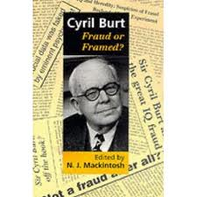
Cyril Burt: committed to the idea that intelligence was innate & static throughout a person’s lifetime.
Posited that individuals could be assigned a place in society based on their ability.
Intelligence tests could be used to provide children with education appropriate to their level of ability
Far reaching effects on education system:
Reorganisation of school classes based on ability
Northern Ireland: 11 plus exams, to identify appropriate second-level school (grammar or public school)
Burt’s research into the heritability of
intelligence was fabricated!
Notes:
Individuals could be assigned a place in society based on their ability

Slide 17
More recent evidence
IQ scores are often stable across time
i.e., if two tests are taken a few months / years apart the results are likely to be quite similar particularly for older children and adolescents.
Test-retest correlations typically range from .70 - .85

Slide 18
However, many children show significant fluctuations in test results
New Zealand longitudinal study: (Caspi et al. 1996, Intellectual performance: Continuity and change)
Around 1000 children re-assessed every 2 years from age 7
10% showed major change: difference of 15 points
13% showed major change across long periods: cumulative shift of 50 points in 6 years
Half of children will show little or no fluctuation, other half will show at least a small change, with around 15% showing a rather substantial shift (Sattler, 2008)
Notes:
From Bee & Boyd (2010) the Developing Child

Slide 19
Some factors that that are linked to increases in IQ
Quality parent-child interactions:
Emotionally responsive
Language-rich
Complex, stimulating environment
High expectations
Operate in children's ZPD
Early intervention e.g. , Head Start, Carolina Abecedarian Project, Milwaukee Project

Slide 20
Education: “A year in education most likely increases IQ by somewhere between 2 and 4 points” (Winship & Korenman, 1997)
Nutrition (e.g., Lynn)
Enriched environments -- Brain plasticity e.g. Rosenzweig
Notes:
Winship & Korenman (1997) Chapter 10 in Intelligence, genes and Success: Scientists respond to the Bell Curve

Slide 21
Brain Plasticity
Studies have shown that intellectual stimulation in the form of “cognitive training” can help to slow down cognitive decline in the elderly and among those with dementia and Alzheimer’s disease (Belleville, Gilbert, Fontaine, Gagnon, Menard & Gauthier, 2006; de la Fuente-Fernandez, 2006; Spector, et al., 2003; Willis et al., 2006; Wilson, et al., 2002).

Slide 22
Brain Plasticity
While neurogenesis (the stimulation of nerve brain growth) is a well-established phenomenon, in the past there has been no known link between engagement in cognitive exercises and improvements in full scale IQ, although improvements in one aspect of intelligence known as fluid intelligence have recently been reported (Jaeggi, Buschkuehl, Jonides & Shah, 2011)

Slide 23
Brain Plasticity
Much of the best support for cognitive training comes from studies examining its effects on stroke recovery and management of dementia in the elderly (e.g., Smith et al., 2009). The skills improved by such training are generic skills like memory and attention that had already been well established at an earlier time (see also Ball et al. 2002)

Slide 24
Brain Plasticity
The big challenge is to show that such interventions do more than simply improve people’s skills at the very tasks at which they practice. What has been missing from these interventions is evidence that training at one task type generalizes at least to real-life situations (e.g., involving problem-solving or remembering) or to other aspects of cognitive functioning.

Slide 25
Jaeggi et al (2008, 2010, 2011)
A promising research programme into the generalized effects of cognitive training has been led by Susanne Jäeggi, John Jonidas and colleagues at the University of Michigan. These researchers found that practice on a demanding memory task known as the dual n-back procedure led to gains in fluid intelligence (the ability to reason and to solve new problems independently of previously acquired knowledge, and denoted as Gf; see Jäeggi, Buschkuehl, Jonides & Perrig, 2008).
The findings suggested that cognitive training may indeed show general effects that extend beyond the task-type used during training. The results were particularly exciting because both fluid intelligence (Rohde & Thompson, 2007) and memory ability (Pickering, 2006) are associated with scholastic success.
The 2011 study also demonstrated that the increases in fluid intelligence were maintained at three month follow up period

Slide 26
Limitations of Jaeggi at al research
It is important to understand that fluid intelligence is only one component of general intelligence, and improvements in fluid intelligence should not be mistaken for improvements in full scale IQ.
Of course, memory and attentional skills are important in an educational context and the n-back procedure likely works in a general way by increasing attention skills and thereby enhancing the individual’s ablility to attend to problems, solutions for which the individual is already capable of providing.

Slide 27
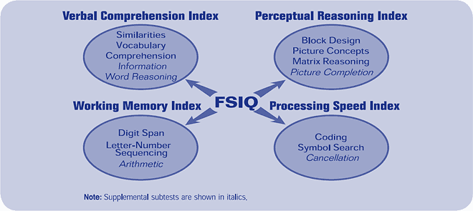
WISC-IV

Slide 28
Behavioural psychologists have also made occasional efforts to improve intelligent behaviour skills (Lovaas, 1987) and have shown large rises in IQ. However, this work was criticized severely on methodological grounds.
Nevertheless, some successful replication has been done of this work. (See Sallows and Graupner, 2005 and Smith, Eikeseth, Klevstrang and Lovaas, 1997)
But these pieces of research did not specifically target general intelligence in their interventions but employed IQ measures as part of a larger range of dependent measures.
Of course, this research is hard to do because it’s so time and labour intensive and intelligence has been such a controversial topic in psychology....

Slide 29
What is Intelligence?
The ability to learn, to understand and make judgements or have opinions that are based on reason.
The ability or abilities to acquire and use knowledge for solving problems and adapting to the world.
A set of skills that allow us to interact successfully with our environments.

Slide 30
“Viewed narrowly, there seem to be almost as many definitions of intelligence as there were experts asked to define it.” --RJ Sternberg

Slide 31
Behavioural Psychologists study the SKILLS underlying intelligent behaviour….
… and we study how to best teach them

Slide 32
IQ is the measure of performance on an IQ test…
RELATIVE to peers.
67%
96%

Slide 33
Behaviour Analysis & Intelligence
Intelligence is commonly believed to lie beyond the remit and descriptive powers of behaviour analysis
Theoretical objections to hypothetical constructs (Skinner, 1974)
Preference for functional accounts
Apparent difficulty in accounting for the generativity of language and cognition
However, advances in RFT have led to new insights into how we might conceive and improve intellectual behaviour.

Slide 34
Intelligence is generally assumed to be a stable trait (Gardner, 1993; Moffitt, Caspi, Harkness, & Silva, 1993; but see Ceci, 1991; Flynn, 1998) with a genetic basis (Jensen, 1969; Plomin, 1990).
IQ test performance scores do in fact predict educational success and several important life factors, such as career success, health and even happiness (Deary, Strand, Smith, & Fernandes, 2007, Jenson, 2002).
But a behavioral approach assumes intelligence to be a malleable skill set with an increasing role played by environmental factors (Cassidy, Roche, & O’Hora, 2010, See Nisbett et al 2012)

Slide 35
Relational Frame Theory and human intelligence
A modern behavioral research programme has been designed specifically to understand how the skills associated with high intelligence might be established in educational interventions.
In a nutshell, RFT is a functional-analytic behavioural theory of human language and cognition.
RFT claims that the foundational skill for most intellectual abilities is Derived Relational Responding.

Slide 36
RFT and human intelligence
What is Derived Relational Responding??
DRR is the skill of relating objects to each other in accordance with a small family of mathematical relationships (e.g. symmetry, equivalence, opposition, more-than, less-than).
Equivalence is the most basic of the relations that can be trained.

Slide 37
Equivalence
From an RFT perspective, THIS is the essence of language. Train ANY relationship between ANY range of objects and NEW relations emerge which weren’t directly trained. So, if you train that A1 is the same as B1 and C1, most verbally able children will be able to tell you that C1 is the same as A1, that B1 is the same as A1 (those are reversing the trained relation) and also that B1 and C1 are the same. Thus, if you train the blue arrow relations, the red arrow relations will also be learned.

Slide 38
Taught
Dog(spoken)
“New”
Verbal response
“Dog”(written)
Derived
Notes:
Given a long enough social history of multiple exemplar training for deriving relations, a child taught to match these stimuli as illustrated by the solid lines, can derive the stimulus relations represented by these hashed lines without reinforcement. This is stimulus equivalence - the simplest form of derived relational responding.

Slide 39
Multiple Exemplar Training
Relations are taught by caregivers across multiple exemplars in normal language interaction (whether the caregiver realizes it or not).
Notes:
Imagine a child is taught that the word “dog” goes with an actual dog and then in another context, perhaps in a different house by a different person, the child learns that “bow wow” also goes with “dog”, in other words, both words refer to the same thing. So, in 2 different contexts, a child learns that 2 different words refer to the same thing. Then in another context a child hears a caregiver or peer use the terms interchangeably or is told explicitly that one word means the other. This child has effectively been shown how to derive an equivalence relation.

Slide 40
Multiple Exemplar Training
By giving a child multiple exemplars, a caregiver is teaching a child skills that become more and more abstracted over time.
From the RFT perspective - all language for humans involves being able to use words in this abstracted way - that is use and respond to words whose meaning has been derived through equivalence.
So according to RFT - language and deriving relations involve the same process.

Slide 41
Relational skills are foundational to language
Relational skills are foundational to language (Lipkens, Hayes and Hayes, 1993, Devany, Hayes & Nelson, 1986; Barnes, McCullagh & Keenan, 1990).
There is a correlation between WAIS subtests and a complex relational skill (O’Hora, Pelaez & Barnes-Holmes; 2005).
O’Toole and Barnes-Holmes (2009) found that fluency at a complex relational task correlated with IQ as measured by the Kaufman Brief Intelligence Test.

Slide 42
Relational skills are foundational to language
Gore, Barnes-Holmes and Murphy (2010) found significant correlations between performance on a test for deictic relations (i.e., perspective taking relations involving “I” and “You”, and “here” and “there” relations) and Full Scale (r = .43), Verbal (r = .45) and Performance IQ (r = .45; p.12) as measured by the Wechsler Abbreviated Scale of Intelligence (WASI; Psychological Corporation, 1999).

Slide 43
Related Experimental Work
Barnes-Holmes, Barnes-Holmes, Smeets, Strand & Friman (2004).
Barnes-Holmes, Barnes-Holmes & Smeets (2004).
Berens & Hayes (2006).
Gomez, Lopez, Martin, Barnes-Holmes & Barnes-Holmes (2007).
These studies all showed that MET was an effective means of
developing relational responding skills and these relational responding skills then successfully generalized to novel stimuli.

Slide 44
IQ Tests are largely tests of relational ability. This can be seen in many tests of intellectual skills/functioning.
WISC-III
WISC-IV
Cognitive Abilities Test
AH4

Slide 45
Implications……
If there is a connection between language, intelligence and relational skills then improving relational skills should improve intelligence (as measured by commonly used IQ tests such as WISC, WAIS).
Barring this research body, no other study to date has attempted to use MET to improve general cognitive abilities.

Slide 47
Cassidy, Roche & Hayes, 2011, Exp 1
Previous preliminary research by the current experimenters found mild and modest correlations between almost all subtests of WISC-III^{UK} and speed of deriving symmetrical and transitive relations.
Providing intensive relational skills training to typically developing children and those with intellectual disabilities raises their IQ by more than one standard deviation
Also found increases of as much as 30 points in full scale IQ scores in a small sample of normally functioning children who participated in a MET intervention designed to raise IQ score.

Slide 48
Cassidy, Roche & Hayes (2011) Experiment 2
8 children presenting with learning difficulties were administered a comprehensive psychometric assessment (IQ and attainment test) and a baseline test of relational abilities.
All children then took part in an intensive relational training intervention programme over the course of an academic year.
All children showed increased relational abilities and increased performance on an IQ test following the research programme. Mean IQ rise was 13 points. Many children moved from the categorisation of intellectual difficulty to the categorisation of “normal range”.

Slide 49
Some demographics
Specific learning difficulty in reading (only)
Borderline ID (x2) Mild General Intellectual Disability,
Mild to moderate delay in comprehension and expression of language, mild to moderate delay in vocabulary development,
Specific learning difficulties in reading, writing and spelling
ADHD
ADHD + Specific learning difficulty in reading and mathematics

Slide 50
Involvement with other professionals
Psychiatrist
Educational Psychologist
Speech and Language Therapist
Occupational Therapist
Learning Support Teacher
Resource Teacher
SNA

Slide 51
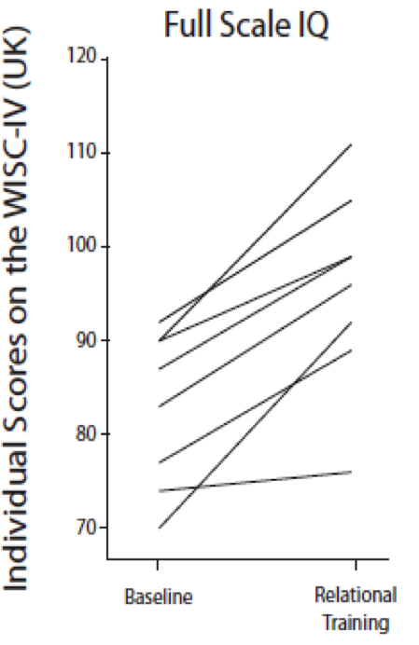

Slide 52
Roche, Cassidy & Stewart, 2013
Children were re-assessed 4 years later and it was found that no child returned to their previously lower than average IQ score. All IQ rises were largely maintained and in many instances, the IQ scores (particularly verbal and reasoning skills) continued to rise.

Slide 53
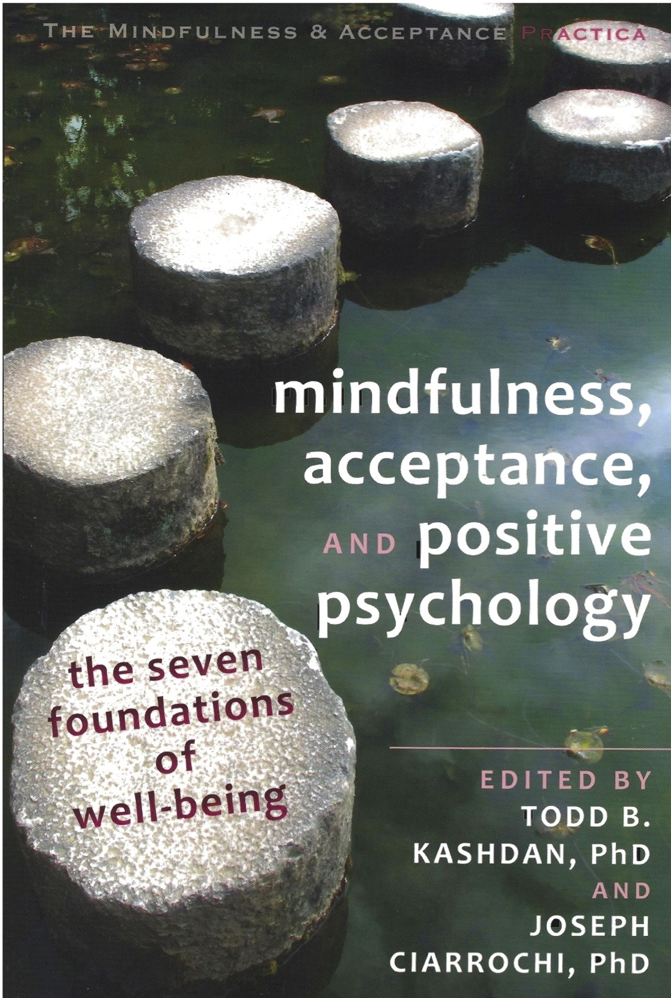
Cassidy et al. (2011, Experiment 2)...
See Roche, Cassidy & Stewart, 2013 for more on four year follow-up
Notes:
82.9
8.3
70-92
95.9
10.6
76-111
102.57
12.19
91-126

Slide 54
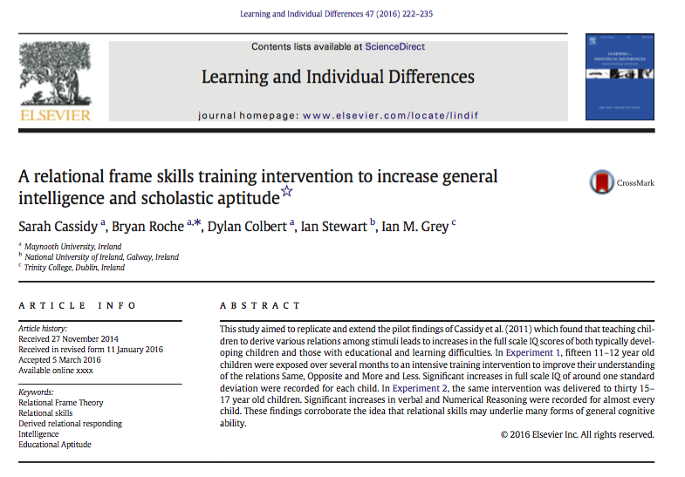

Slide 55
Rathmore study (Exp. 1, Cassidy, Roche, Colbert, Stewart & Grey, LAID, 2016)
Replication of Cassidy et al (2011), using an online relational skills training intervention as offered at RaiseYourIQ.com
Fifteen mainstream school children (normal IQs)
Administered the WISC-IV UK, standard scholastic tests, and a specially designed Relational Abilities Index (RAI).
Twice weekly training sessions in Same, Opposite, More-than/Less-than relational responding.
All baseline tests re-administered following training

Slide 56
Rathmore Study
55 training and testing stages
100% accuracy and high speed required on each block of training and testing
16-20 weeks to complete
All stimuli were nonsense syllables
Every training and testing trial was unique – only the FORMAT of derived relational responding was taught

Slide 57
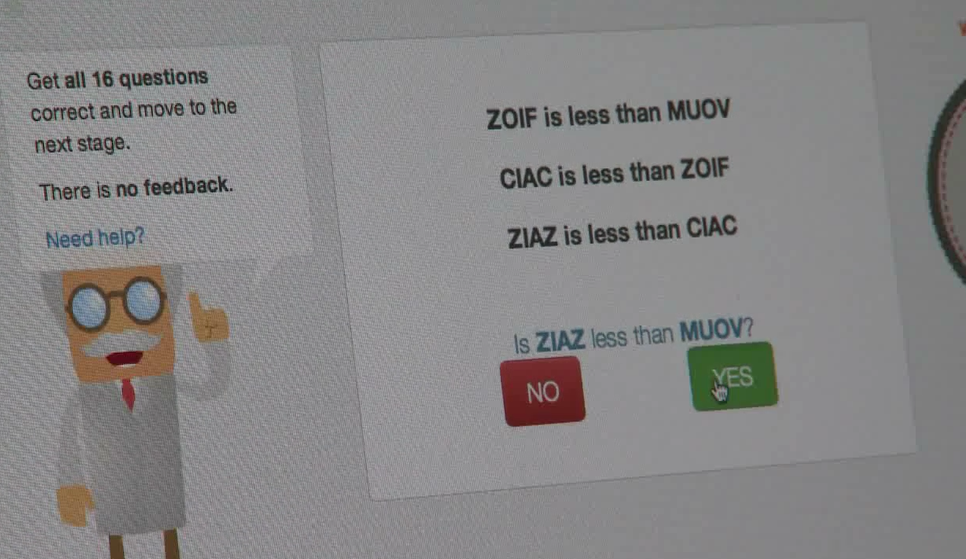
Sample trial from one level of training….
Relational Statements
Relational Question
30s to Respond
Notes:
On each training trial a task like this one in presented, consisting of several relational statements and a relational question. The participant has to derive a stimulus-stimulus relation in each case, from the arbitrary relations represented by the statements. Other levels of training involve other relation types and mixtures of relation types. Test blocks consist of 16 novel tasks presented without feedback.

Slide 58
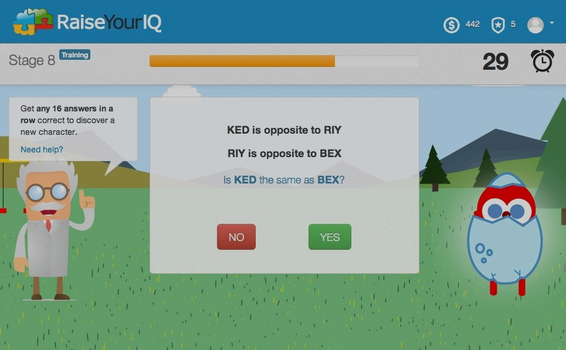
Notes:
Here is another example involving Opposite relational statements, and a question in terms of a frame of Sameness or coordination.

Slide 59
RAI Scores
Increase in relational abilities was significant (t=7.235, df =14, p<0.000).
Effect size (Cohen’s d) = 1.89 (very large).

Slide 60
Full Scale IQ Scores
The increase in IQ from baseline to follow up was significant (t=19.18, df =14, p<0.000).
Effect size = 4.96 (Cohen’s d, very large)
Notes:
The average IQ score at the baseline was 97 (average intellectual range). The average IQ score at the follow-up was 120 (superior intellectual range). This represents an average IQ rise of 23 points.
The range of IQ rises was from 14 points to 32 points. The increase in IQ was significant and the Effect size was very large.

Slide 61
Increase in IQ Percentile Rank

Slide 62
IQ Rises by Diagnostic Category

Slide 63
Sigma T Sten Scores
Sigma T test measures standard mathematical ability in Irish Schools.
Increase in Mathematical ability was significant (t=1.87, df=14, p<0.05, one-tailed)
The Effect Size (Cohen’s d) was 0.5 (medium).
Notes:
Narrative: The Sigma T test measures standard mathematical ability in Irish Schools. This graph represents STEN scores for the Sigma T for each of the 15 participants. The sten scores rose on average from 6.06 to 6.66. This increase in Mathematical ability was significant, with a medium effect size.

Slide 64
Micra T Sten Scores
Micra T test measures standard reading ability in Irish Schools.
Increase in Reading ability was not significant (t=1.45, df=14, p>0.05)
The Effect Size (Cohen’s d) was 0.37 (medium).
Notes:
Narrative: The Micra T test measures standard reading ability in Irish Schools. This graph represents STEN scores for the Micra T for each of the 15 participants. The sten scores rose on average from 5 to 5.46. This increase in reading ability was NOT significant, BUT there was a medium effect size.

Slide 65
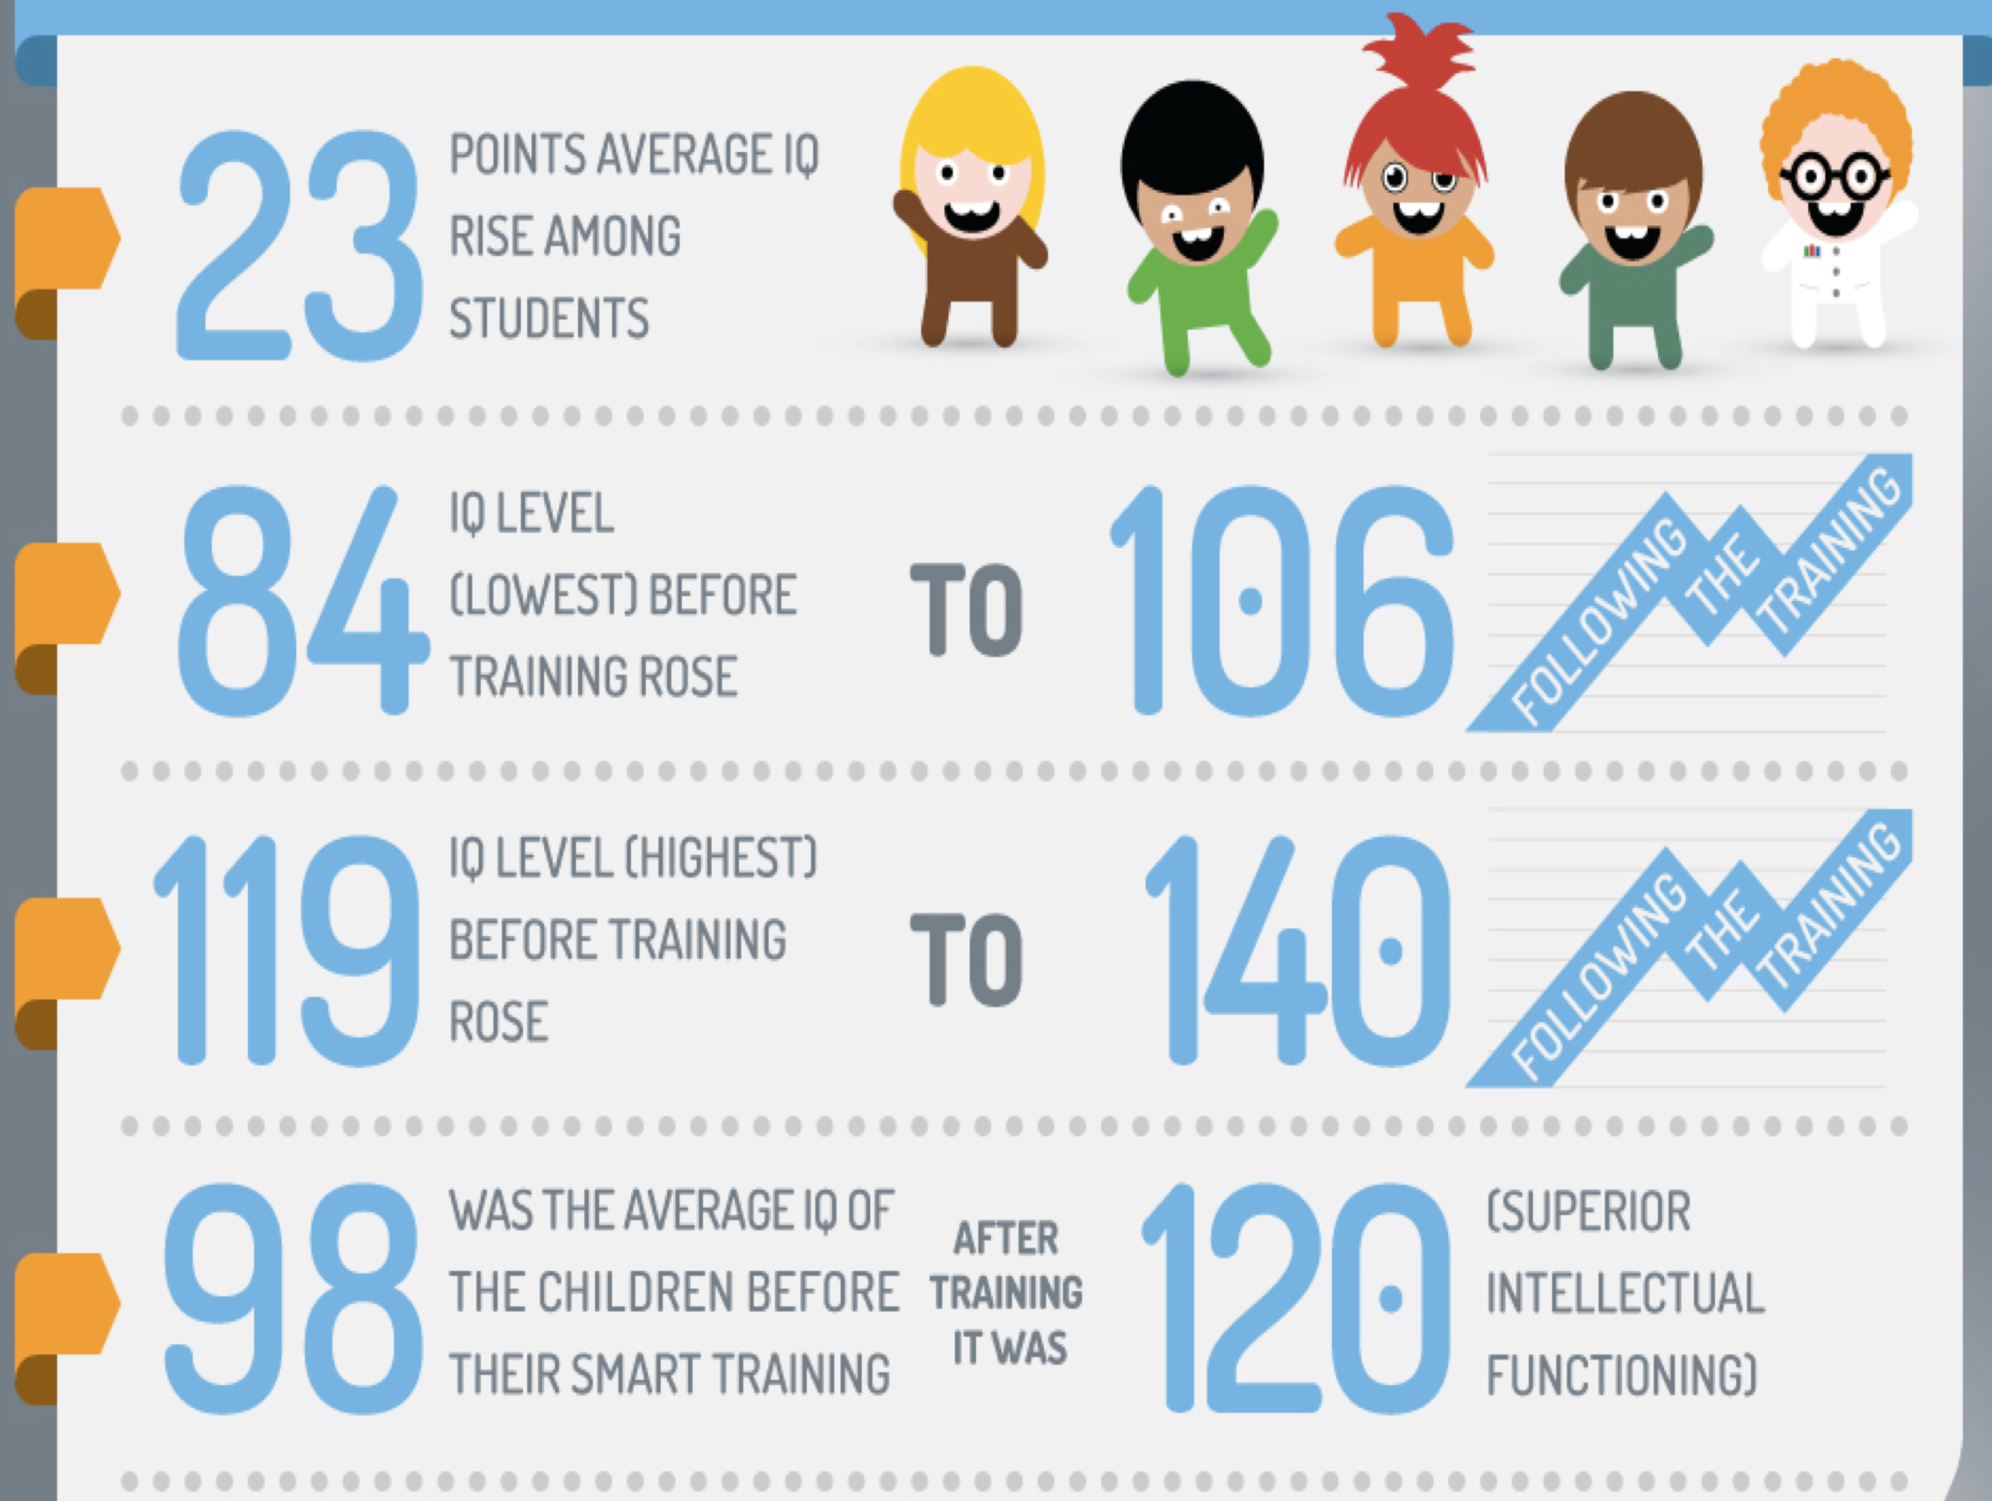
Notes:
Summary – read it all out in Plain English ad-libbing – or at least the highlights

Slide 66
Exp 2, Cassidy, Roche, Colbert, Stewart & Gray (2016)
Same intervention delivered to 30 15-17 year old mainstream students
Baseline measure Differential Ability Test (DATs) administered by school
Students took part in training 2-3 sessions per week over the course of their normal school week
Training supervised by teachers
Results of DATs scored by external and blind 3rd party–(commercial psychometric company)

Slide 67
Exp 2, Cassidy, Roche, Colbert, Stewart & Gray (2016)

Slide 68
Exp 2, Cassidy, Roche, Colbert, Stewart & Gray (2016)
RAI Scores: A mean relational abilities index score of 44.7 out of 55, or 81.3% correct, (SD = 5.7) was recorded at baseline. This rose to 51.3 out of 55, or 93.3% correct (SD 3.84) post-intervention.
This increase was significant, z (29) = 4.451, p < .001, indicating that scores rose from pre to post-intervention as expected. The Cohen’s d effect size for this increase in relational ability was large at 1.52 (Cohen, 1988).

Slide 69
Exp 2, Cassidy, Roche, Colbert, Stewart & Gray (2016)

Slide 70
Exp 2, Cassidy, Roche, Colbert, Stewart & Gray (2016)
Verbal Reasoning: Scores on the Verbal Reasoning subtest of the DATs rose from a mean score of 63.2 (SD=22.8) to a mean score of 69.5 (SD=23.1) from pre to post-intervention.
This increase proved to be significant (t (26) = 2.979, p = .006). A Cohen’s d effect size statistic of 0.4 (medium) was calculated for this increase in verbal reasoning ability.

Slide 71
Exp 2, Cassidy, Roche, Colbert, Stewart & Gray (2016)

Slide 72
Exp 2, Cassidy, Roche, Colbert, Stewart & Gray (2016)
Numerical Reasoning: Scores on the Numerical Reasoning subtest of the DATs rose from a mean score of 54.5 (SD=21.2) to a mean score of 67.6 (SD=20.0) from pre to post-intervention.
This mean increase of 14.87 points (SD=14.61) proved to be significant (t (29) = 5.572, p < .001). A Cohen’s d effect size statistic of 0.68 (large) was calculated for this increase in numerical reasoning ability.

Slide 73
Exp 2, Cassidy, Roche, Colbert, Stewart & Gray (2016)

Slide 74
Exp 2, Cassidy, Roche, Colbert, Stewart & Gray (2016)
Educational Aptitude. The Educational Aptitude (or Scholastic Ability) score is a composite score calculated for each participant using their Verbal and Numerical Reasoning scores. Scores on this composite scale rose from a mean of 58.9 (SD=20.9) to 68.5 (SD=18.0) from pre to post-intervention.
This mean increase of 17.1 points (SD=17.0) proved to be significant (t (26) = 5.207, p <.001). A Cohen’s d effect size statistic of 0.73 (large) was calculated for this increase in overall Educational Aptitude. SIGNIFICANT INCREASE

Slide 75
Exp 2, Cassidy, Roche, Colbert, Stewart & Gray (2016)
Discussion: Very exciting results showing that we have replicated the IQ rises that were shown to be possible in Cassidy et al (2011).
We have also shown that this training programme can foster statistically significant rises in verbal reasoning, numerical reasoning and overall scholastic ability even when the training is administered in larger, busier classroom settings with less scientific control that might be seen in a lab setting.
Externally validated results seen in Exp 2
Still need to do a lot more research with larger numbers and matched control groups

Slide 77
Colbert, Tyndall, Roche & Cassidy (in press in Journal of Behavioural Education)
29 mainstream school young people (age 15-17)
Spilt into two groups (n=14, n=15)matched for baseline IQ.
WASI administered at baseline and follow-up
Passive control group (n=15)
Twice weekly training sessions for Same, Opposite, More-than/Less-than relational skills
WASI re-administered following training (four months)
IQ testers were completely blind to the conditions

Slide 78
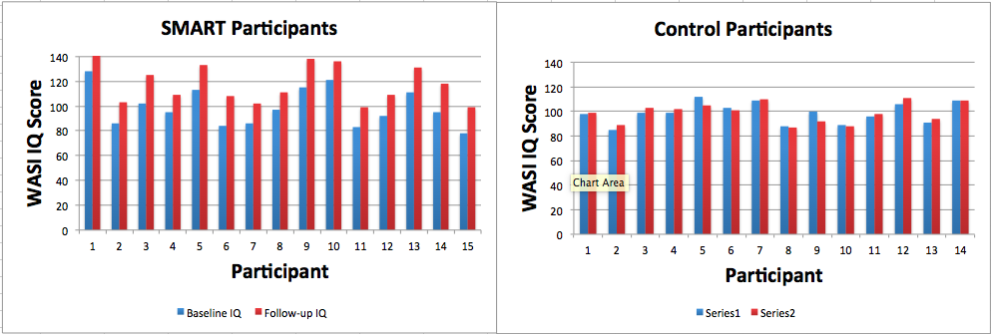

Slide 80
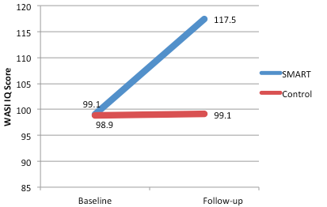
Full Scale IQ scores in the SMART group increased by more than one full standard deviation on average (i.e., 18.4 points).
This represents a mean percentile rank increase of over 31% from approximately the 47th percentile (M = 99.14) at Baseline to the 88th percentile (M = 117.47) at Follow-up.

Slide 81
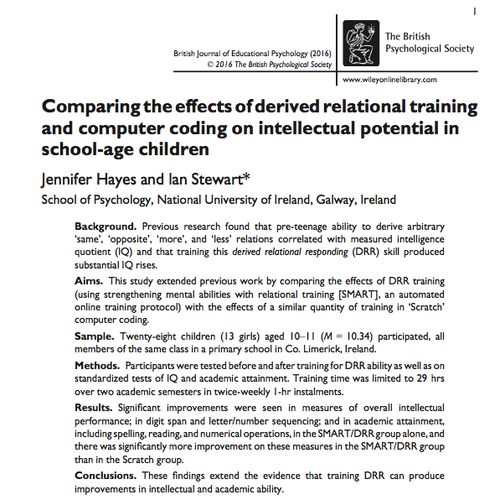

Slide 82
Hayes & Stewart, BJEP, 2016
This study aimed to replicate and extend Cassidy et al 2011 by comparing effects of DRR training (using SMART, an automated online training protocol) with the effects of a similar quantity of training in ‘Scratch’ computer coding developed at MIT.

Slide 83
Hayes & Stewart, BJEP 2016
28 children (13 f and 15 m, mean age 10.34 years, all members of the same class in a primary school in Co. Limerick, Ireland)
Participants were tested before and after training for DRR ability as well as on standardised tests of IQ and academic attainment. Training time was limited to twenty nine hours over two academic semesters in twice weekly 1 hour instalments.

Slide 84
Hayes & Stewart, 2016
Results: Significant improvements were seen in measures of overall intellectual performance (WASI) ; in digit span and letter / number sequencing (WISC-IV); and in academic attainment, including spelling, reading and numerical operations, in the SMART/DRR group alone, and there was significantly more improvement on these measures in the SMART/DRR group than in the Scratch group.
Conclusions: These findings extend the evidence that DRR training (SMART training) can produce improvements in intellectual skills and academic ability.

Slide 86
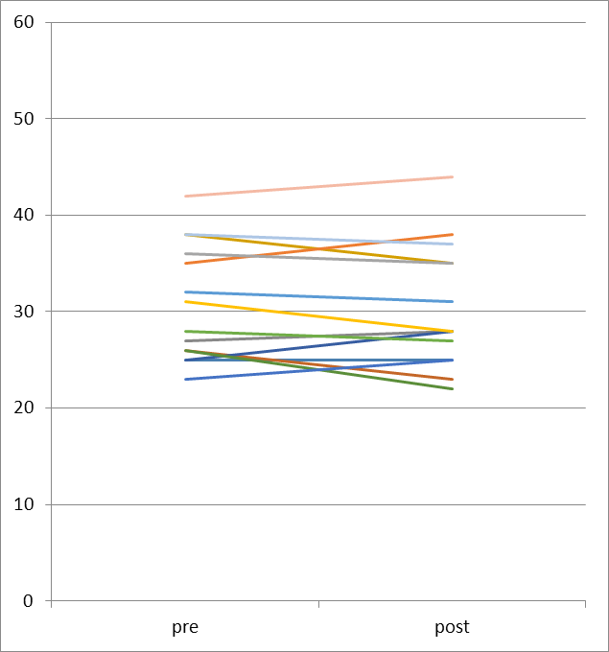
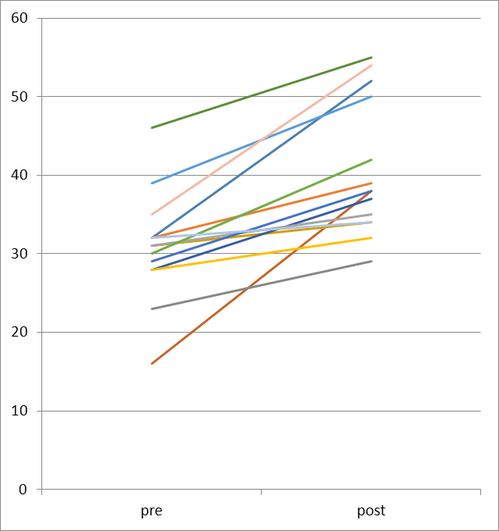
Individual Data: Relational Ability
Scratch
SMART

Slide 87
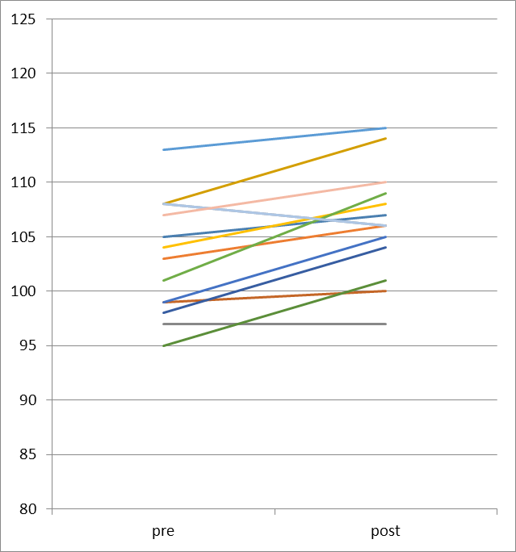
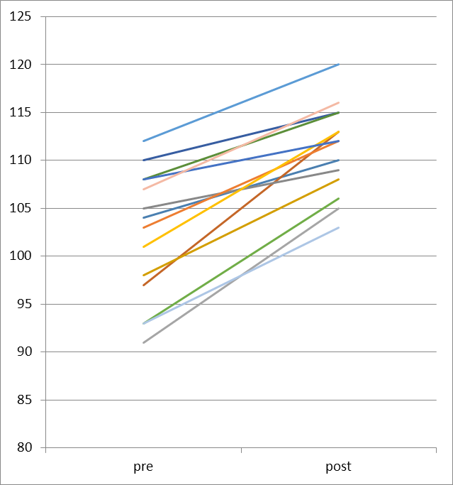
Individual Data: Reading
Scratch
SMART

Slide 89
O’Donovan, Stewart, Roche & Hogan (NUIG)
39 older adults and 35 younger adults
Mini Mental state exam, IQ test, Relational abilities test, Word recognition test
Found significant correlations between relational skills and IQ, and verbal skills and IQ, irrespective of age (e.g., those that had strong relational skills also did well on the other tasks)
This has important implications for using relational training to prevent/deter cognitive decline.

Slide 90
Bourke & Stewart, under review
20 early school leavers who have returned to 3rd level via access route
All were administered IQ tests, RAI tests and tests of reading comprehension
10 were given 4 months of SMART training
10 received no intervention
There were no significant differences in any scores at baseline, but SMART students outperformed control group on every measure following the intervention
This study is currently being replicated and extended to include larger numbers and an active control group (e.g., cross word puzzles, etc) and further groups of non-traditional learners

Slide 91
Amd & Roche (2017, Psych Record)
This study demonstrated that students who received the most training in SMART showed significant IQ gains on the Ravens Matrices (RPM) in a group of social disadvantaged children

Slide 92
Amd & Roche (The Psychological Record)

Slide 93
Presti, Torregrossa, Cumbo & Roche (in Preparation) ….
Prospective, randomized, 6 month, parallel- group study comparing Cholinesterase inhibitors (ChEIs) vs SMART training + ChEIs as treatments for Alzheimer’s Disease.

Slide 94
Measures Pre and Post…..
o MODA (Milan Overall Dementia Assessment)
o Coloured Progressive (CPM) and o Attentive matrices.
Participants were trained on MET for SAME, OPPOSITE only for 3 months.
Sessions lasted 90 minutes, once per week.
SMART stages completed ranged from 30 to 35
Sessions were supervised by a psychologist

Slide 98
But What About other Skills?
Scores on measures of attention can increase as a function of attention training for both typical children and those with ADHD
Effects strongest on sustained attention & divided attention
Weakest on selective attention
Results are mixed in respect of transfer to fluid intelligence
Sarzynska et al (2017) - 4 games to improve attention but NO transfer to general intelligence

Slide 99
Roche, Grey, Cassidy, Colbert and Stewart (in preparation)
Training Group
Control Group

Slide 100
There was a significant IQ gain in the intervention group t (-2.709) = p. 01. No significant gain was found for the very small control group.

Slide 101
Significant increases on selective & everyday attention. Changes in sustained attention approached significance.

Slide 102
Results and Conclusion
There was a significant difference for the intervention group between baseline and post intervention scores t (-2.709) = p. 01. No significant difference observed for control group.
No change on standard scores of working memory for intervention group (IQ rise therefore cannot be explained by working memory gains).
Significant changes on selective attention and everyday attention index
Change on sustained attention approaching significance
Need to run more controls
Ideally need active controls
Need larger samples and attainment tests as dependent measures.

Slide 103
Smart Starter
If anyone wants to talk to us about piloting a new program for children ages 5-7, come and talk to me after the presentation.
Bryan is testing this out with Ian Grey in Abu Dhabi right now and we are anticipating positive results with younger kids who perhaps don’t have English as a first language or who haven’t acquired fluency at reading yet.

Slide 104
Research underway
Further replications and extensions underway at Summerhill College (Cassidy, Roche, Colbert, Gannon)
Examining larger groups doing training supervised by teachers as opposed to by psychologists
Results for relational abilities and IQ scores have been overwhelmingly positive so far

Slide 105
LMETB (Cassidy, Roche & Gannon) In preparation
Currently examining the utility of SMART with a group of adult early school leavers who are known to have literacy difficulties. 7 experimental participants, 5 matched control participants who will be a wait-list control group. Have measured IQ scores, self esteem and attention skills and completed full literacy assessments
Currently examining utility of SMART for increasing relational ability, self esteem and attentions skills

Slide 106
LMETB
Results have indicated a statistically significant rise in attention skills, self esteem, reading and spelling, but not IQ scores for severely dyslexic adults who also presented with borderline to mild intellectual difficulties.
N is very small so data is still under analysis right now (discussed tomorrow at symposium with Ian and Nanni in Rue St. Catherine at 10:35).

Slide 107
Other collaborations
Currently developing a SMART spin-out to develop more flexible thinking with a population of youths who are experiencing OCD and are considered “treatment failures” (with Lisa Coyne)
Similar intervention being developed with Ian Tyndall for non clinical populations. Ian has also been doing some work here looking at temporal relations and there is a paper that has just been accepted in EJOBA also which Ian can describe better than I can.
Kid Starter (non-arbitrary rels) and FAST

Slide 108
Why else does this matter?
Clearly, we now have a strong and ever growing body of evidence that demonstrates that relational skills form the very building blocks of intelligence and teaching these skills will increase students’ abilities to access the academic curriculum in all subject areas. But more importantly, the problem solving skills that we are training are important in many real world contexts, not just the classroom.
We are also showing that we can yield increases in areas of attention skills, level of self esteem, potentially even providing real assistance with dementia and alzheimers!
The scope of this training programme for helping various populations of learners is vast and appears to be growing exponentially.

Slide 109
It is very easy to finish your training and to be very idealistic about all the people we are going to help and to be naïve about how effective we are going to be because we have so much training and so much knowledge. I think the real world throws something a little different at us. The contingencies change. But this “something different” is our job. It is our job, as educators and psychologists, to work with and for the children in front of us….not the kids we used to teach, not the kids we would like to teach, and not just the ones that are easy to teach. It is our job to teach all of them, just as they are.

Slide 110
Now we can!
Perhaps for the first time in the history of psychology we have an educational technology with which we can literally nurture genius as well as supporting various different types of challenges learners (of all ages) who most need our help face, but for whom we very rarely have enough resources to properly support their needs.
But if we’re going to do this…..

Slide 112
Questions???

